Slide 1
Programming in the 21st Century:
Trends and Tools to Improve Gender Equity in Choral Music Programs
National ACDA 2021 Conference
Notes:
Thank you Mike for that wonderful introduction. And thank you all for being here with us as we discuss Programming in the 21st Century:
Trends and Tools to Improve Gender Equity in Choral Music Programs. My name is Elaine Bennington and I am one of three people who will be presenting in this conversation my pronouns are she/hers.
From Amanda H. Littauer
Associate Professor of History & Center for the Study of Women, Gender, and Sexuality
Northern Illinois University: "Female" and "male" are terms that refer to biology rather than social identity, so current practice would be to use "women and men" when you need to refer to the gender of conductors in the past. When you do not need to specify, it is best to use the plural form of conductors and they/them pronouns (rather than using a singular "universal" conductor with he or she pronouns).

Slide 2
Who We Are
Elaine Bennington (she/her), Performing Arts Educator at Clarendon Hills Middle School (IL) and Choral Database Co-coordinator at the Institute for Composer Diversity
Helena von Rueden (she/her), Associate Professor of Music at Hampden-Sydney College and Assistant Director and Choral Database Co-coordinator at the Institute for Composer Diversity
Rob Deemer (he/him), Professor of Composition at the State University of New York at Fredonia and Director/Founder of the Institute for Composer Diversity
*** Art used in this presentation was created by artists from underrepresented *** heritages. Follow the links to learn more about them.
Notes:
PRONOUNS

Slide 3
Creating Common Ground,
Definitions, and Questions
Notes:
We want to start this conversation by establishing a common viewpoint as we discuss gender equity and its importance in choral programming. Many of these ideas, terms, and questions are not new, but they are important to acknowledge..

Slide 4
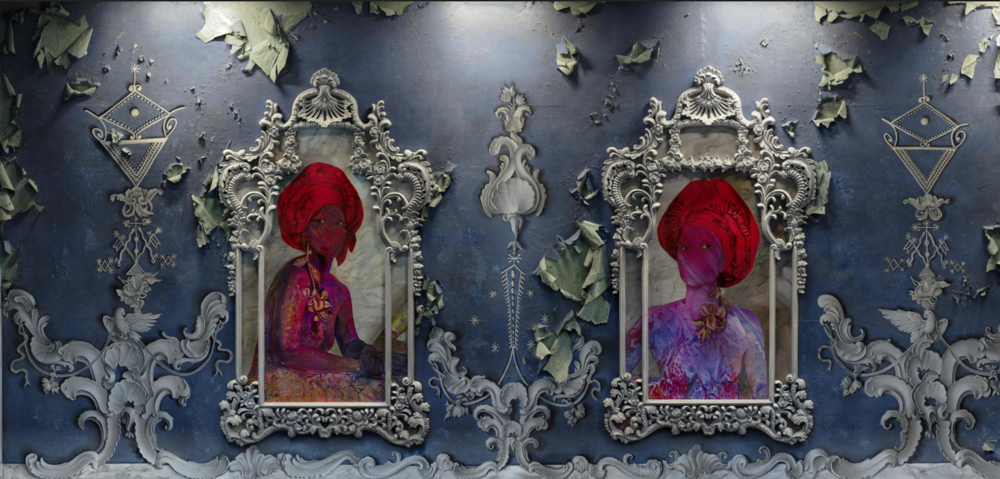
Mirrors and Windows
Guiding Question:
What windows and mirrors are we as a larger choral community building for our students, performers, and audience communities?
“Imagine the neglect of a curriculum which teaches a female student to look always through the window at the art done by others while ignoring the art of the quilt made by her own grandmother which is reflected in the mirror of her very own bedroom.
By now it should be obvious that some of the "missing" great women artists were making quilts. But, if what is close to home and reflected in your own mirror is excluded from the very definition of art, your gaze will only see "the windowed half" of art history. Such an education will be unbalanced, incomplete and inaccurate — though pretending to be otherwise.” - Styles, 2013
Installation View of “The Modern Window”: Firelei Baez Photo by John Wronn
Notes:
The first concept roots itself in the Mirror and Windows educational philosophy of Emily Styles. We create opportunities for our students and ensemble members to see themselves, their culture, and their heritages through mirrors and the opportunity to see different cultures, perspectives, and heritages through windows. These mirrors and windows are created through the music we program and the authors we amplify. Styles has a powerful quote illustrating the importance of these mirrors, which I have posted on this slide and invite you to read. When our students and ensemble members see themselves responsibly reflected in the curriculum, they feel empowered and can better understand themselves, their culture and their heritage. Windows respectfully looking into different cultures and perspectives allow our students and ensemble members to have a deeper understanding of those around them When we program quality music, every work can be a mirror and a window. However, representation in our mirror and windows matter. The more variety in our programing, the richer and deeper the experience for our students, ensemble members, ourselves, and our audience communities.

Slide 5
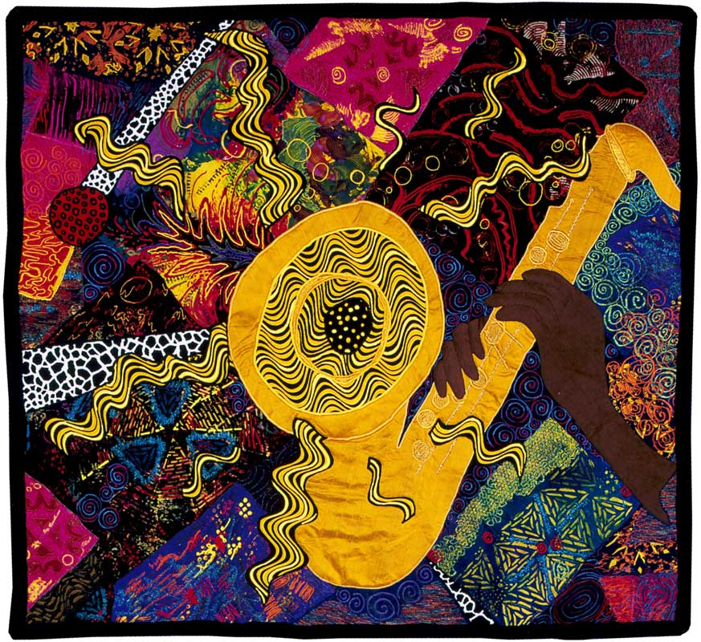
Creating Common Ground
This is an ongoing conversation
Diversity in thought, culture, and traits are positive assets
Diverse perspectives and voices provide richer experiences and broader contexts
  Students
  Self
  Audiences
Jazz-Hot [Quilt] Gwendolyn A. Magee (1943-2011)
Notes:
We also want to acknowledge that these conversations are ongoing. We are one thread a beautiful tapestry of conversation and discussion. We entered this presentation and this conference with questions regarding equity, diversity, and inclusivity. We do not propose to have all the answers, though we do invite you to ask questions in the chat - which we will answer at the end of the session. Rather, we will present where we feel we historically have been as a choral community, and provide resources for us to continue to look towards the future with hope for further inclusivity within our choral programing.

Slide 6
Determining Gender
Website and online resource analysis for pronoun use
Priority given to personal websites, professional bios, ICD composer-submitted bios
Defining Gender
Woman - female identifying, she/her pronouns (includes transgender women)
Man - male identifying, he/his pronouns (includes transgender men)
Nonbinary - identifying as neither, both, or other, with mixed use of pronouns or use of different pronouns
Source: American Psychological Association
Defining Authors
Composer, arranger, editor, transcriber
Notes:
There are many ways to look at diversity and inclusivity within our choral program. Our conversation and research focused specifically on gender. As we searched for gender identities of choral authors, we placed priority on personal websites, professional bios, and biographical data authors gave directly to the Institute for Composer Diversity. We classified someone as Woman by use of she/her pronouns, Man by use of he/him pronouns, and nonbinary through mixed pronoun use or use of different pronouns. When we talk about choral authors we are looking at composers, arrangers, editors, and transcribers. Any level of authorship was included in our data and every level of authorship is equal.

Slide 7
Trends at Different Levels
High School All-State Performances
ACDA Conference Collegiate-level Performances
Implicit Value Judgement for Works Selected
Programs → Curriculum → Contexts and Perspectives for students, performers, and audiences → Amplification of voice and perspective
Notes:
We focused on two specific trends: High School All-State and ACDA Conference Collegiate-level Performances. Works programed here are amplified , and given an implicit value judgement. I know from my own experience teaching high school in the chicagoland area, that the repertoire that’s selected for the ILMEA all-state ensembles has often becomes the first quarter curriculum for participating ensembles, which frames the context and perspectives for ensemble members, audiences, and our large communities. These pieces can easily spread beyond the elite ensembles to join choral libraries and programs throughout the state and nation.

Slide 8
Research Question:
In what ways have high school all-state honor choirs and ACDA collegiate performances amplified woman authors (composer, arrangers, transcribers, and editors) through programming?
Institute for Composer Diversity Guiding Metrics:
25-35% living composers
15-25% women composers
15-25% composers from underrepresented heritages
Notes:
Knowing that representation and amplification matters, we wanted to look at the ways high school all-state honor choirs and ACDA collegiate performance amplified women authors in their programing. We also wanted to look at how this programing compared to the ICD guiding metrics of having 15-25% of music programed in a season including a woman author. These ICD metrics are one of many ways to reflect upon programing. They were originally designed to look at works programed over an orchestral season, but they are a good place to start the conversation in the choral world as well.

Slide 9
High School Performance Trends
Notes:
Now it’s time to look at the data.

Slide 10
Counting Women Authors in All-State Performances
Works by women authors (composer, arranger, editor, transcriber) are all counted equally
Examples:
  Rosephanye Powell - “Still I Rise”
  Alice Parker and Robert’s Shaw’s Arrangement - “Vive L’amour”
  Craig Hella Johnson’s arrangement of Carly Simon’s “Let the River Run”
  Kristina MacMullen’s edition of Chiara Margarita Cozzolani’s “Ave Regina Caelorum”
Notes:
Because of the differences in format, and in data quantity Helena and I chose to analyse our data slightly differently. As we discuss the trends at the High School All-State level, works by any number of women authors have equal weight. Rosephanye Powell’s work “Still I Rise” counts as one piece with at least one woman author, which has the same value as Kristina MacMullen’s edition of Chiara Margarita Cozzolani’s “Ave Regina Caelorum”.

Slide 11
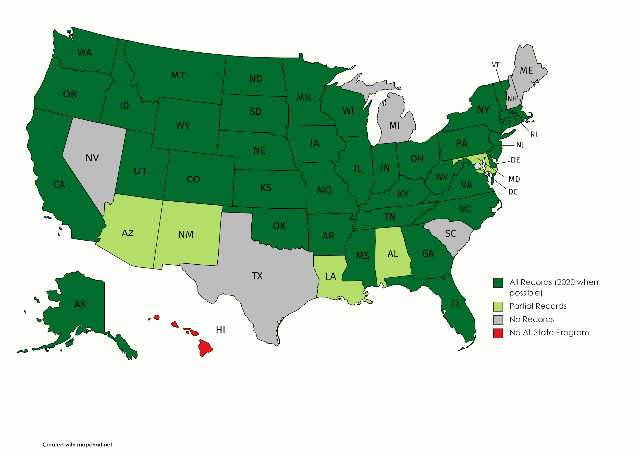
Data Collection
Data from 42 States ( N=42)
  Contact with All-State Leadership
  Online Programs
  Conference Recordings
2014/15-2019/2020
  2020 included whenever possible
Missing: ME, NH, NC, SC, MI , TX, NV
Notes:
I collected data from 42 different all-state programs. The states in deep green gave me complete records for the 2014-2015 through the 2019-2020 academic school years. 2020 All-State programs were included whenever possible, regardless of whether the all-state event occurred or was cancelled due to the Covid-19 Pandemic. It’s assumed that those pieces were still amplified through purchase, discussion, and rehearsal. States colored light green have incomplete records in the data set, and Hawai’i does not hold an all-state program.

Slide 12
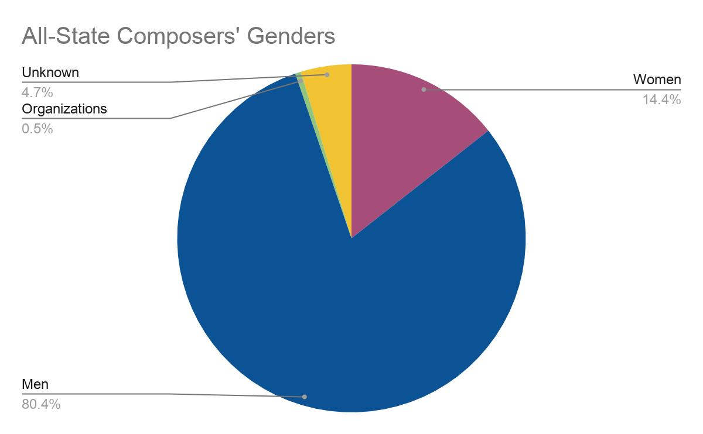
National Findings
2550 songs performed - 452 with at least 1 woman author (18%)
1833 Unique Songs (Each voicing a different piece) - 310 with at least 1 woman author (17%)
1733 Unique Songs (No acknowledgement of voicings) - 288 with at least 1 woman author (17%)
767 Authors
  Men: 615
  Women: 110
  Organizations 5
  Nonbinary: 0
  Unknown: 36
    Composition award winners,
    missing bios, editors,
    international composers
    referenced in another source
    with no gender identifiers
Notes:
Over those 6 years 2550 works were performed, with 452 (or approximately 18%) of those works featuring at least one woman autho. This within the ICD recommendation guidelines. There were 767 authors programmed. 615 men, 110 women, 5 organizations (like colleges and community groups) and there were 36 authors with unknown genders. These tended to be composition award winners or international composers who were missing bios or personal websites. There were no identifiable nonbinary authors programed acorss the 50 states during those 6 years.

Slide 13
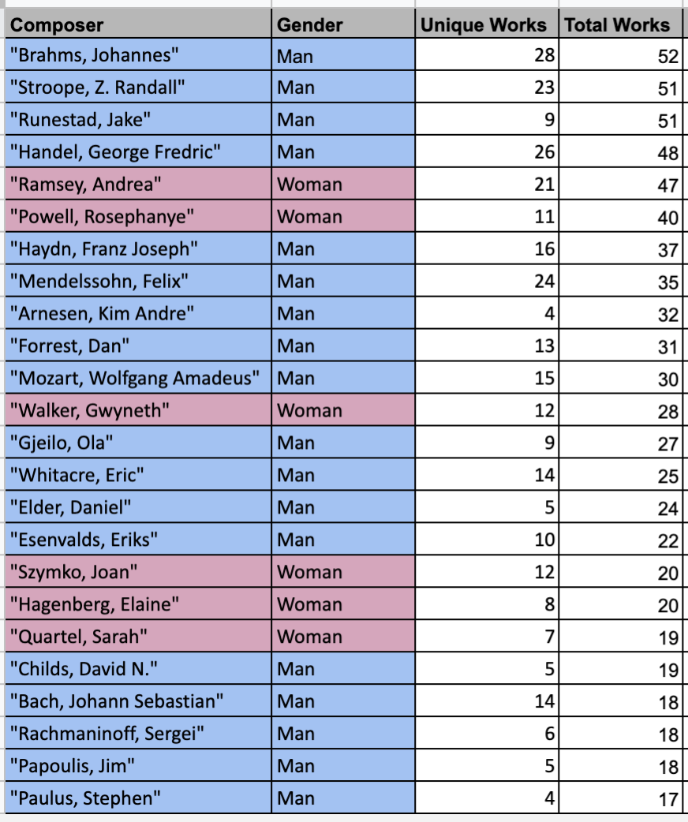
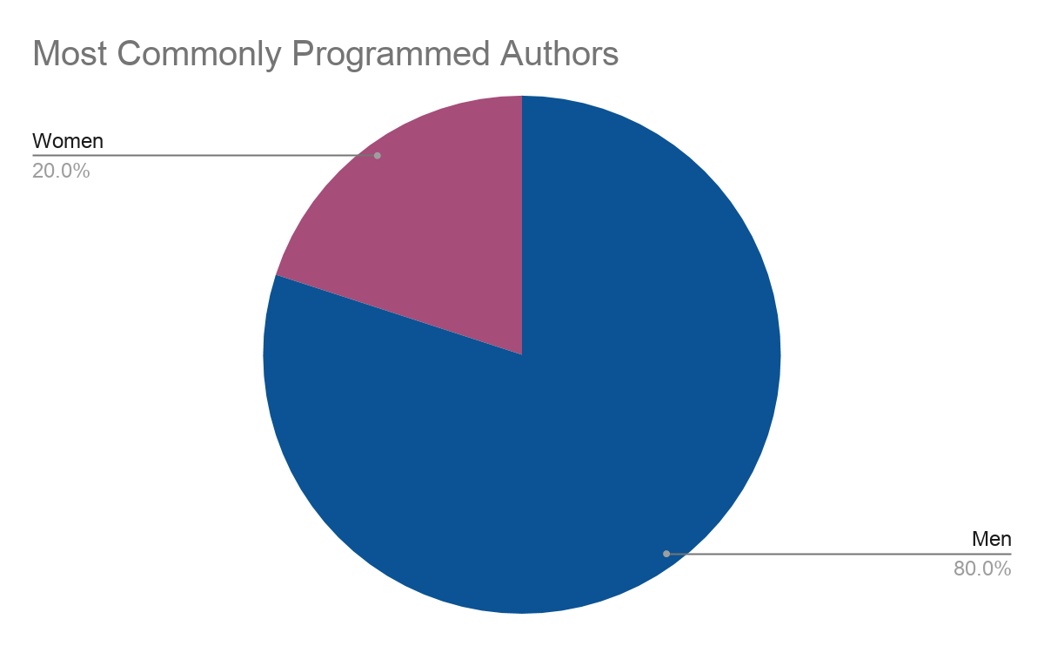
National Breakdown of 2014/2015 - 2019/2020
Most Commonly Programmed Authors
  24 Total
  6 Women
  18 Men
  0 Nonbinary/Unknown
Notes:
Within those 6 years, 24 authors were programed more than 15 times. Of those, 6 (or 25%) were women. 18 of them were men, and there were no nonbinary authors.

Slide 14
National Breakdown of 2014/2015 - 2019/2020
These 6 most commonly programmed women composers collectively had 174 works programmed
  Unique Works and Total Works
5% of woman authors comprise ~39% of all works programmed with at least one woman author
Notes:
The graph on the right breaks down each composers unique and total works programmed during the 6 year time frame. These 6 most commonly programmed women collectively had 174 works programmed. The six composers represent 5% of the total women authors, but comprised approximately 39% of all programmed works with at least one woman author. While this representation is good. I think we can continue to promote more voices with rich, varied perspectives. IFor example, only 1 of of these authors is a woman of color.

Slide 15
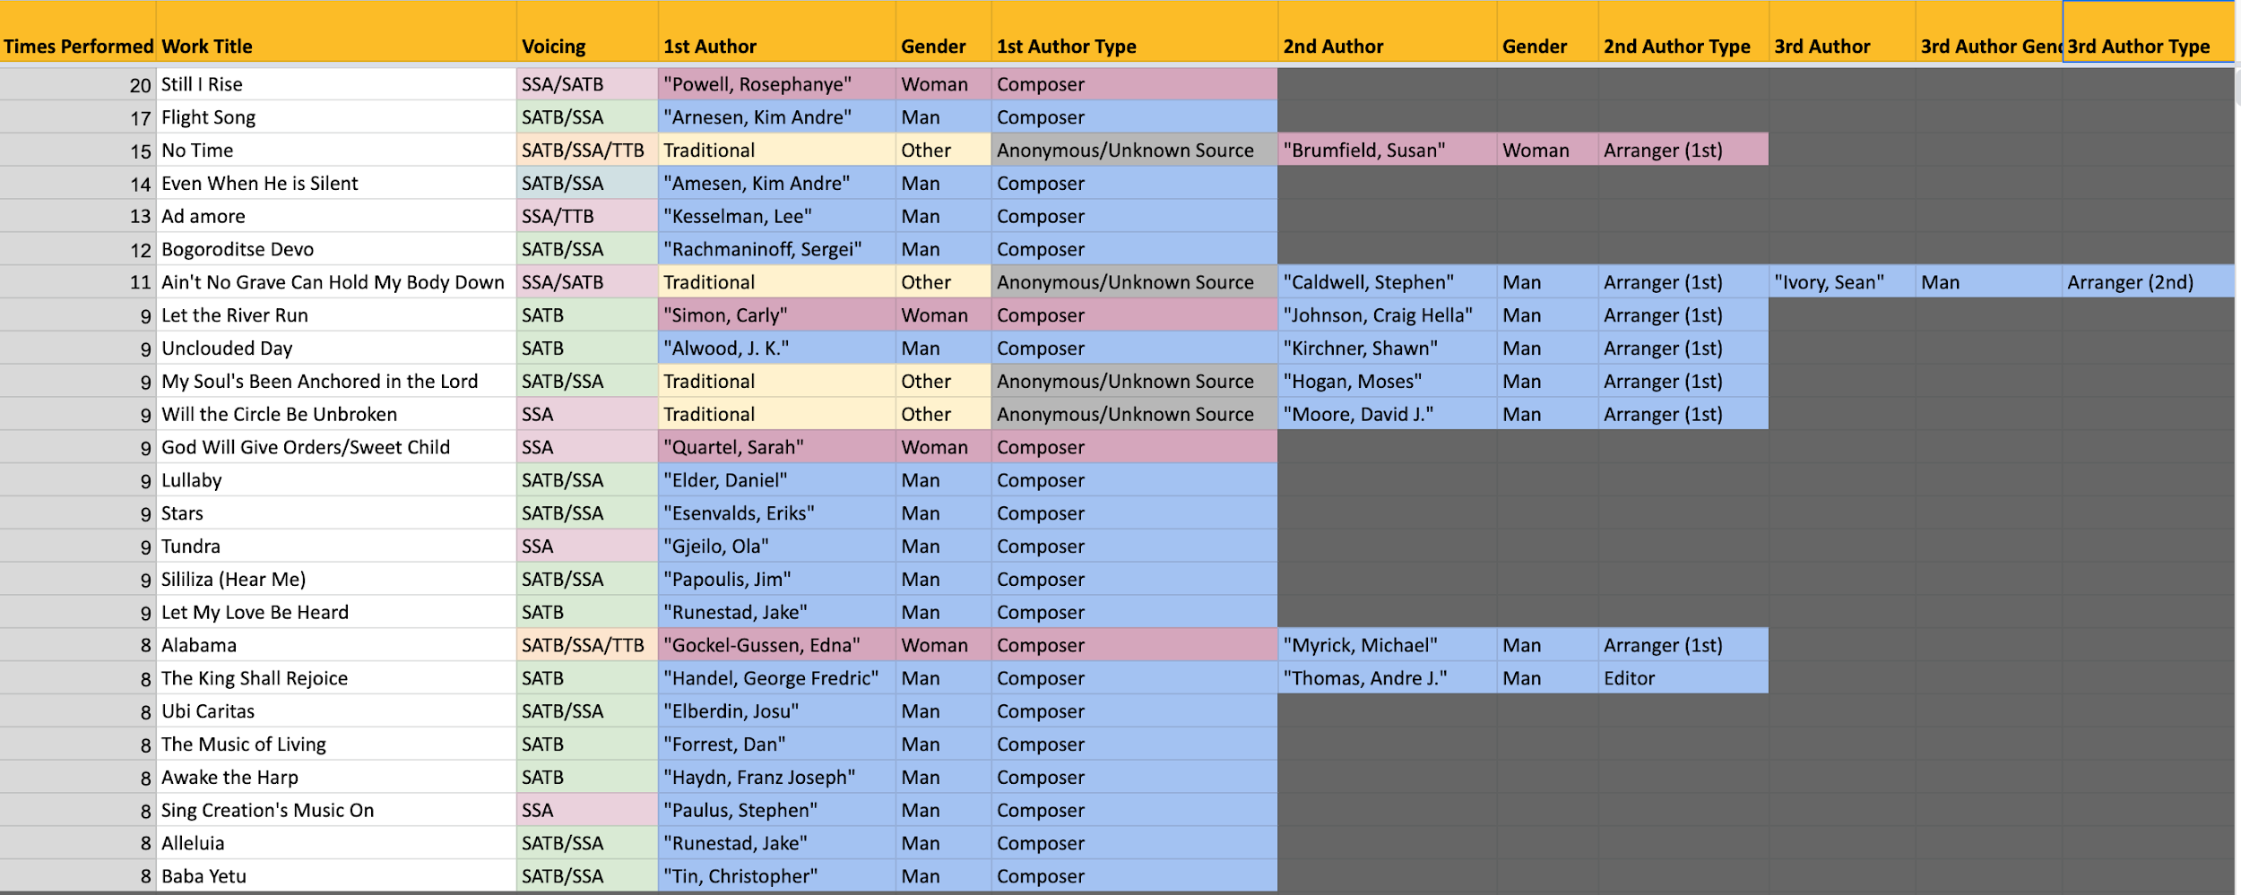
National Hits of 2014/15-2019/2020: Works performed 8+ Times
Notes:
(10:00)This is a breakdown of all the works programmed 8 or more times over the 6 year period. I know that this image has a lot of data in it, and might be hard to read on some screens. Our interaction on this platform is limited, as I walk you through all that’s included in this image, if you see a piece that you have programmed over the last three years, I invite you to raise your mechanical hand. I know my mechanical hand would be up.
The far left column counts how many times the work was performed in any voice setting. We then see the work title, all programed voicings, and then the different authors for the piece, including their names, genders, and type of authorship.
Within this breakdown, there are 25 works total, of the 25 authors, 5 are women, 20 are men, and none are nonbinary or have an unknown gender.

Slide 16
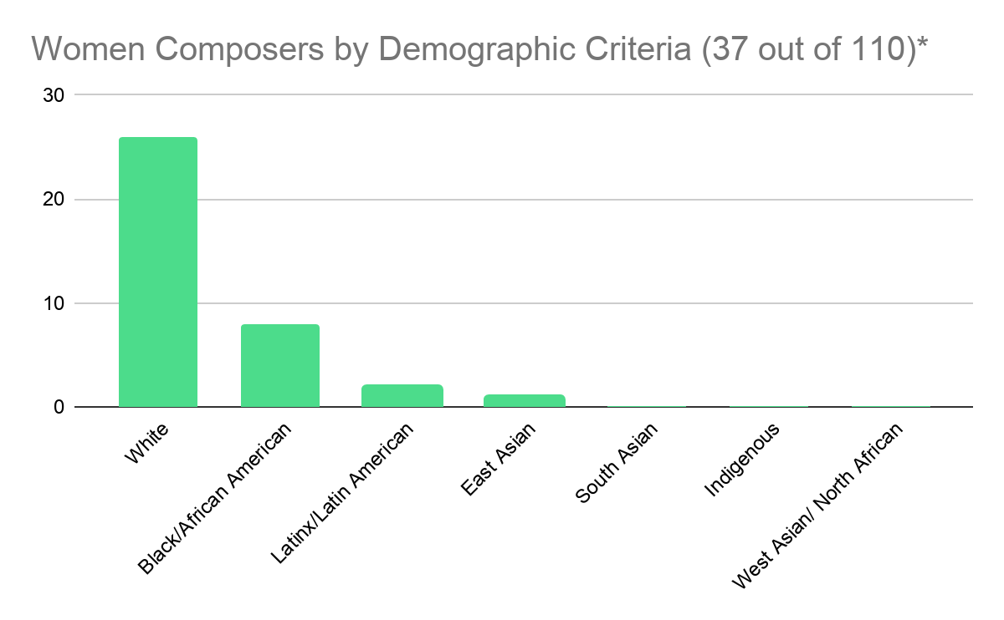
26
8
2
1
0
0
0
Notes:
Of the 110 women represented in the data, I found biographical information for 37 of them. 33 of them submitted their own demographic information on the ICD composer database. Six referred to their demographics on their websites but are not currently listed in the ICD database.
37 confirmable racial demographics (34%)
26 White
8 Black/African American
2 Latinx/ Latin American
1 Korean

Slide 17
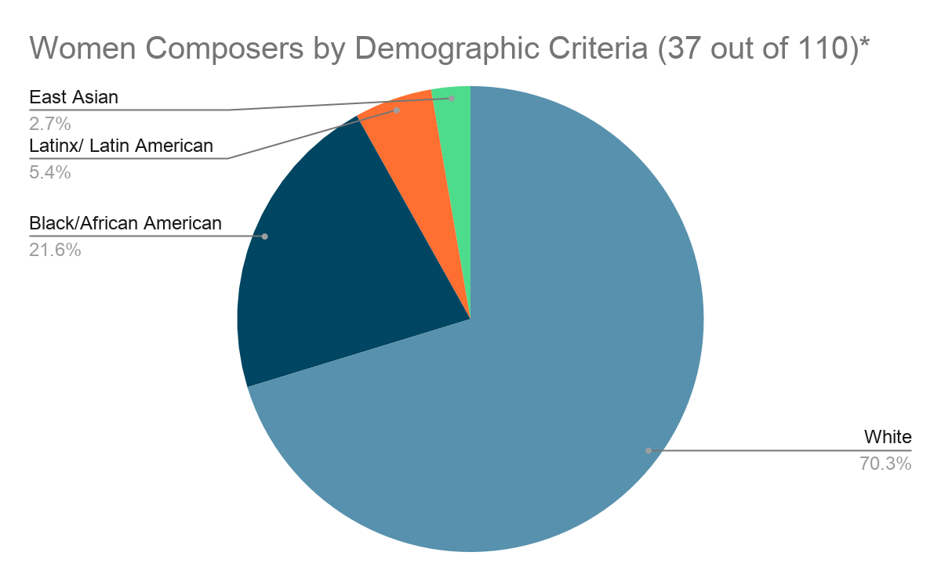
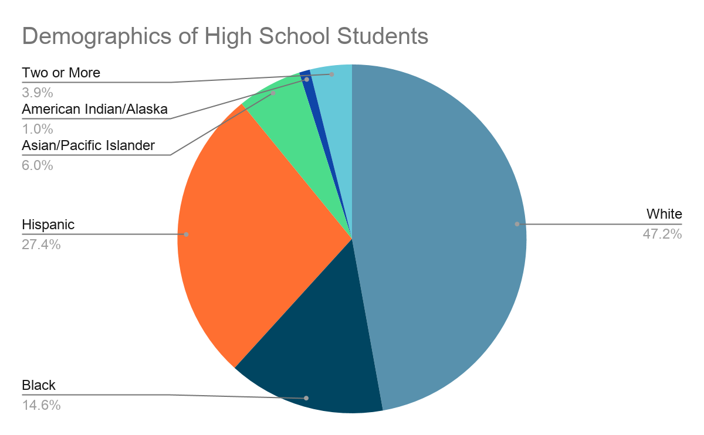
https://nces.ed.gov/programs/digest/d19/tables/dt19_203.60.asp
Notes:
When we compare these demographics on the left to the national high school student population on the right, as reported by the National Center for Education Statistics, we can see that while we are taking steps in the right direction, we have a lot of opportunities to continue to provide windows and mirrors for our high school communities. As you can imagine there are a lot of different ways to analyse this data. It would certainly be interesting to compare this data with demographic information on all high school all-state choral participants or the full dataset of composers.

Slide 18
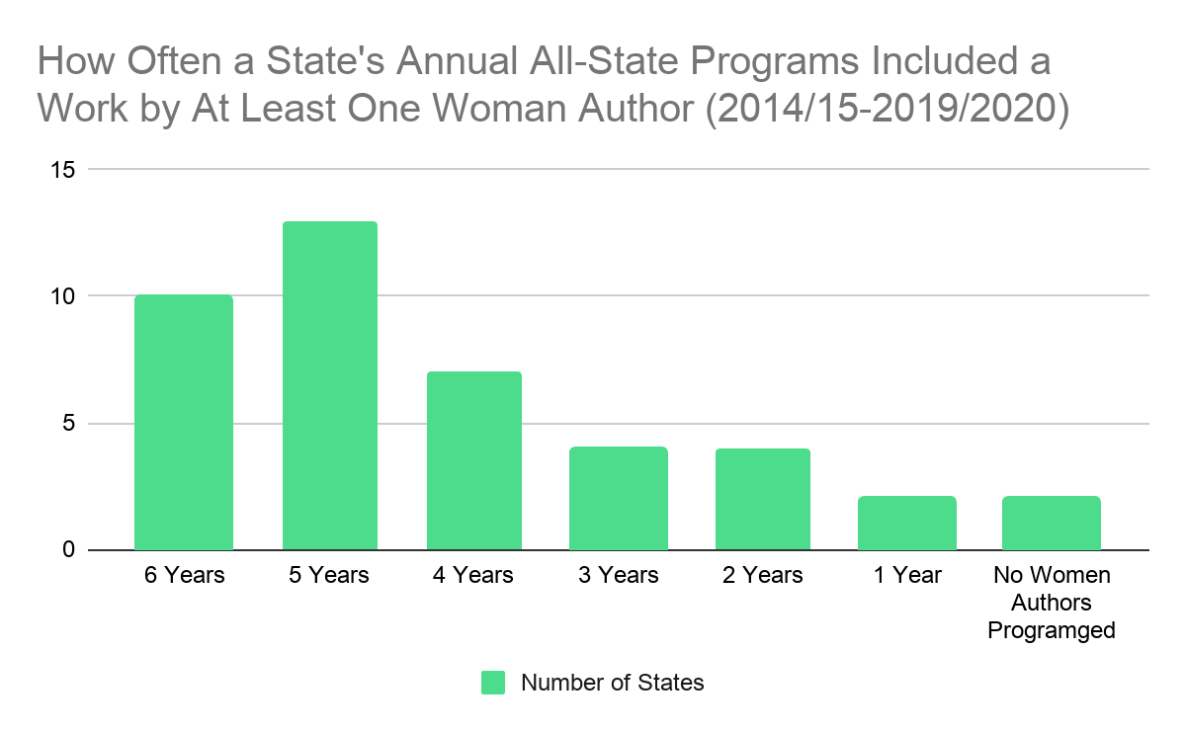
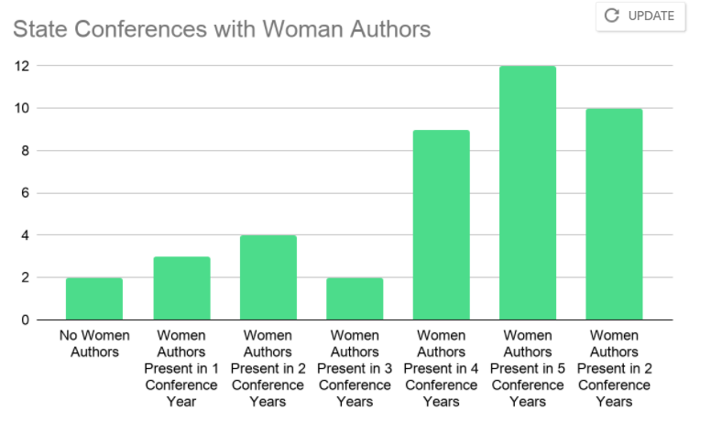
13
13
10
10
7
7
4
4
4
2
2
2
2
4
No Women Programed
No women authors programed
in any conference year
Women
authors
present in 1
conference
year
Women
authors
present in 2
conference
years
Women
authors
present in 3
conference
years
Women
authors
present in 4
conference
years
Women
authors
present in 5
conference
years
Women authors
present in all 6
conference years
Notes:
While we have been looking at national trends, it’s important to note that each state controls their own all-state choral programming. On this slide, each column depicts the number of years an all-state program included a work by at least one woman author over the 2014/15-2019/2020 time frame. For example, 13 states programmed a work with at least one woman author in five of the six conference years of data, while two states have no programmed works by any female authors in the records provided. It’s important to point out that because not all states had records for 2019-2020 all-state programs, overall these numbers might be higher.

Slide 19
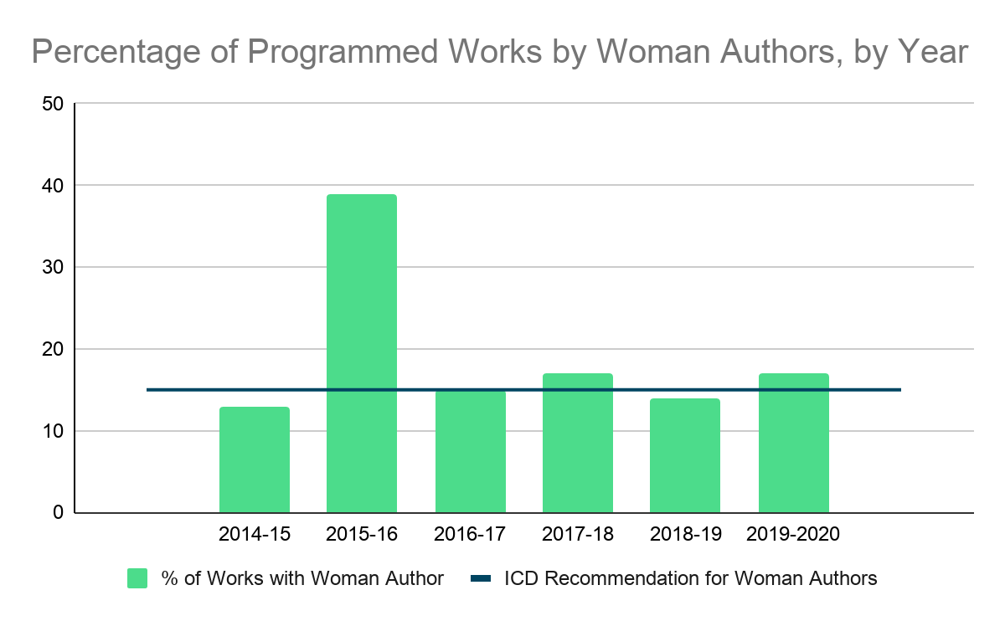
39%
15%
17%
14%
17%
13%
Notes:
When we analyze the data by year, we notice that overall, the all-state choir program are meeting the ICD recommendations of having 15-25% of music programed in a season include a woman author. While there is not enough time to present data at the state level, the information presented thus far can help inform other macro and micro trends. As I mentioned at the beginning of the presentation, our community is a rich tapestry of voices. There are so many layers and directions that we can dive into, and the high school all-state programs are one thread to examine. And I appreciate the opportunity to discuss this sliver of data. I’m now going to pass the virtual microphone to my partner Helena as she presents another trend in our choral tapestry.

Slide 20
Collegiate Performance Trends

Slide 21
Number of Programs/Number of Works at ACDA Conferences | Number of Choral Programs | Number of Works
Regional Programs (2016-2020) | 115 | 701
National Programs (2015, 2017, 2019) | 30 | 184
Totals (2015-2020) | 145 | 885

Slide 22
Number of Individual “Authors” (Composer/Arranger) represented on 2015-2020 Collegiate Programs | Number
Men | 472
Women (incl. 1 transgender) | 84
Nonbinary | 0
Total | 556

Slide 23
Counting Women Authors in Collegiate Performances
Each author (composer, arranger, editor, transcriber) is counted equally for a “Total Authorship” value
Example: Alice Parker and Robert’s Shaw’s Arrangement “Vive L’amour” = 1 count for women’s authorship + 1 count for men’s authorship

Slide 24
Number of Performances by Composer/Arranger Gender | Performances of works by 1st composer | Performances of works by all “authorships”*
Women | 102 (11.6%) | 145 (12.8%)
Men | 705 (80.1%) | 916 (81.0%)
Nonbinary | 0 | 0
Unknown/anonymous | 68 (7.8%) | 69 (6.1%)
Total | 875 | 1130
*Includes 1st, 2nd, and 3rd composers and 1st, 2nd, and 3rd arrangers where applicable. For example, a Parker/Shaw arrangement

Slide 25
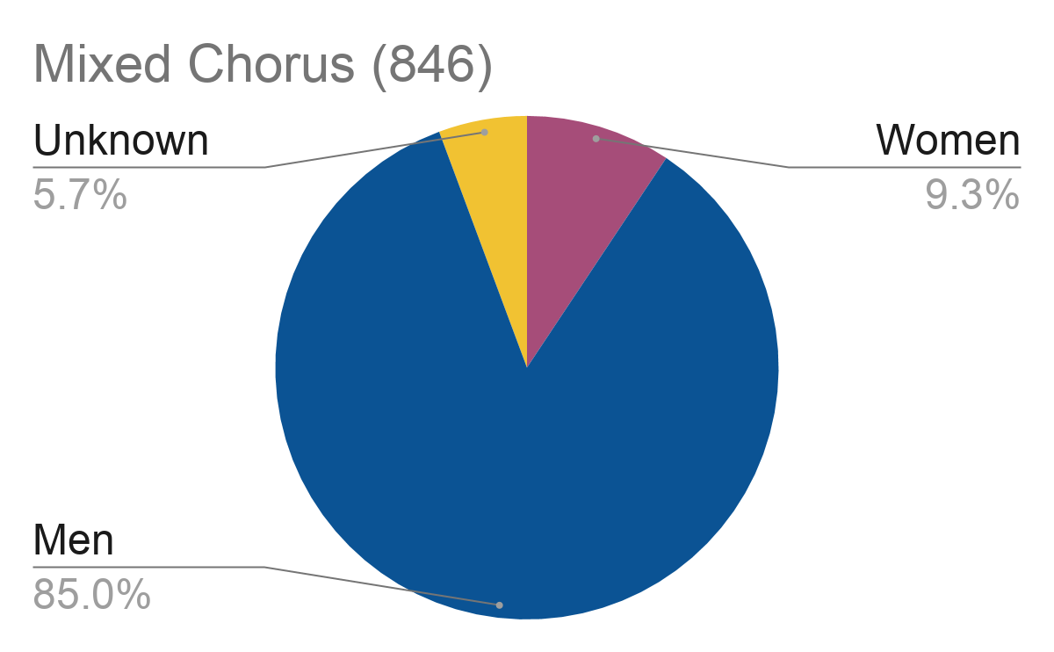
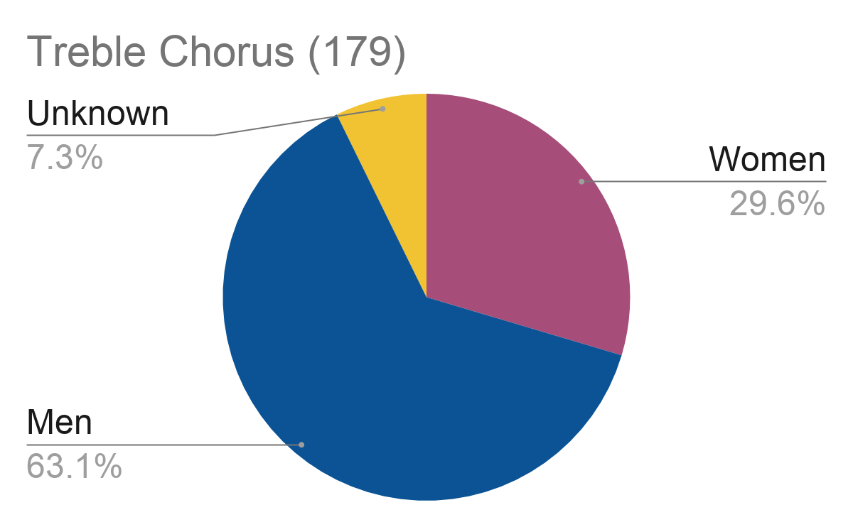
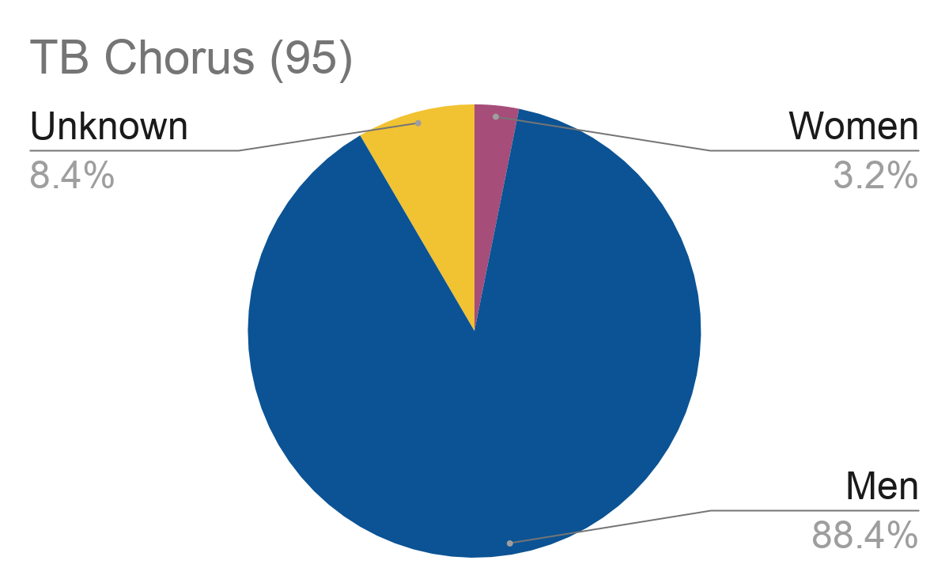
Works Performed by Gender Identity of Authorship by Ensemble Type
Notes:
This are performance of works numbers.

Slide 26
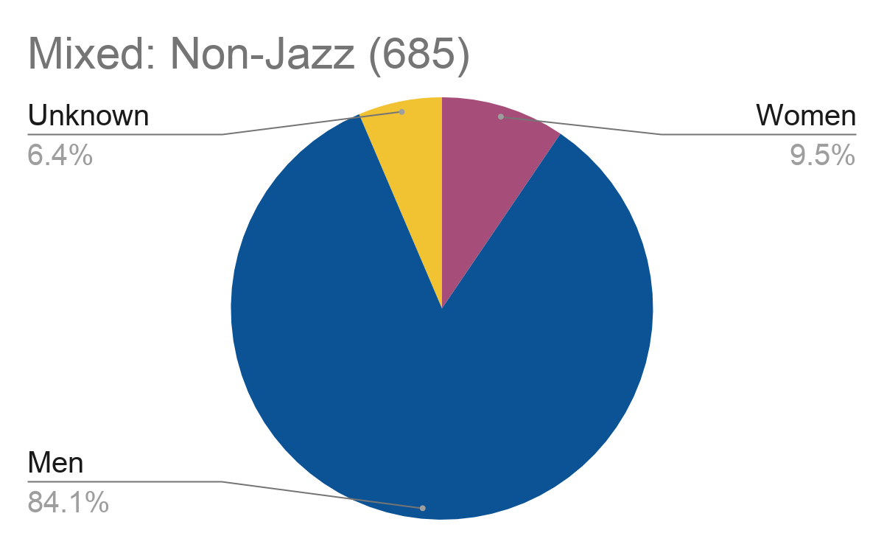
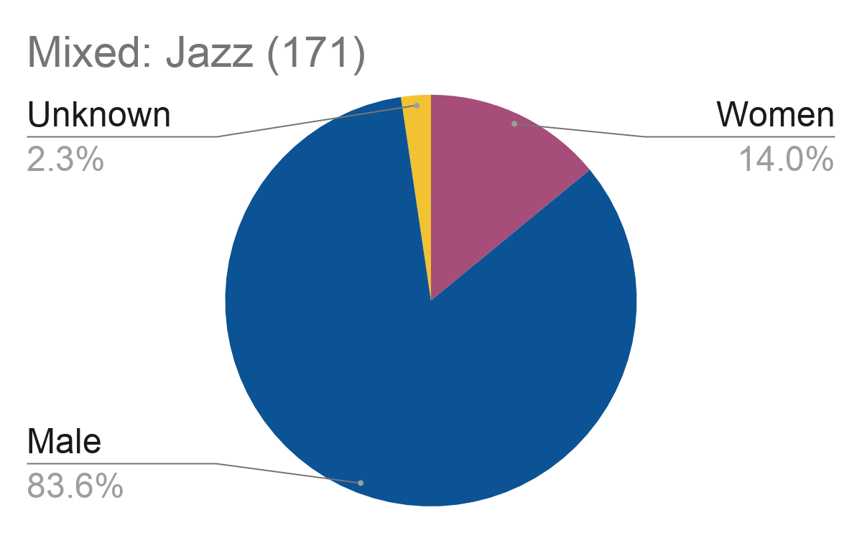
Works Performed by Gender Identity of Author and Ensemble Type
Notes:
This are performance of works numbers.

Slide 27
Composers performed
8 times or more
(men and women)
Composer | # performances | Gender
Ešenvalds, Ēriks | 23 | M
Runestad, Jake | 18 | M
Gibbs, Stacey V. | 15 | M
Bach, Johann Sebastian | 14 | M
Brahms, Johannes | 13 | M
Meader, Darmon | 12 | M
Tormis, Veljo | 11 | M
Shaw, Caroline | 10 | F
Pärt, Arvo | 9 | M
Handel, George, Fredrich | 9 | M
Barnum, Eric William | 9 | M
Marsh, Kerry | 9 | M
Monteverdi, Claudio | 8 | M
Betinis, Abbie | 8 | F

Slide 28
Women composers
performed at least
3 times
Composer | # performances
Shaw, Caroline | 10
Betinis, Abbie | 8
Hagen, Jocelyn | 6
Hagenberg, Elaine | 5
Parker, Alice | 4
Woo, Hyo-won | 4
Barnes, Jennifer | 3
Eckert, Rosana | 3
Jensen, Joni | 3
Mvula, Laura | 3
Parton, Dolly | 3
Price, Florence | 3
Quartel, Sarah | 3
Ramsay, Andrea | 3
Trumbore, Dale | 3
von Bingen, Hildegard | 3
Walker, Gwenyth | 3

Slide 29
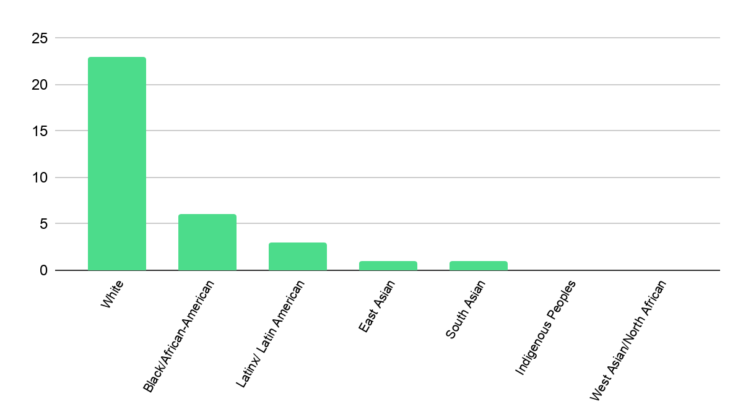
Women Composers by Demographic Criteria (34 out of 84)*
67%
17%
8%
3%
3%
Notes:
79 women represented in the data. 33 of them gave their own demographic information on the ICD composer database. One referred to her demographics on her website but is not in ICD. These are the 34 whose data are shown here.

Slide 30
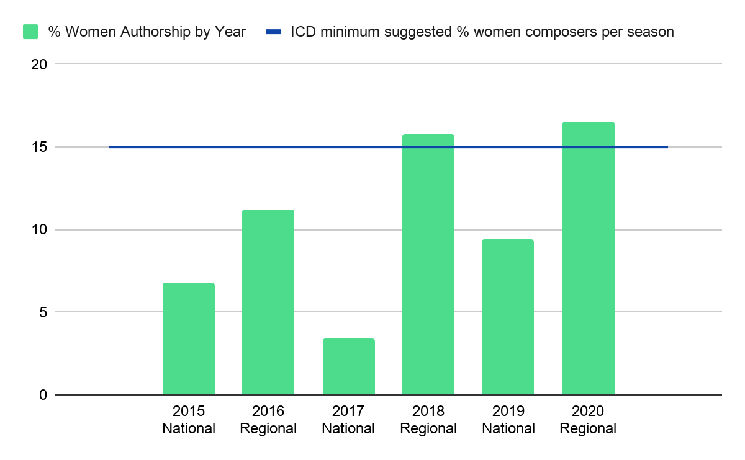
Percentage of Women Authorship by Conference Year
15.7%
16.5%
11.2%
9.4%
6.8%
3.4%

Slide 31
Internet tools for finding works by women composers

Slide 32
Different Tools for Different Purposes
Finding scores appropriate for your ensemble
Deeper learning about works and composers new to you
Training in any new performance practices the works represent
Taking all steps avoid tokenism of women composers on programs
  Tokenism: Choosing repertoire only to check a box, or fill a quota, to absolve oneself of deeper responsibilities
Notes:
Move to the end of helena’s section

Slide 33
Social Media
Helpful for:
Announcements about new initiatives, composer commissions, competitions
Deeper learning about specific composers or works
Discussing challenges and ideas with others

Slide 34

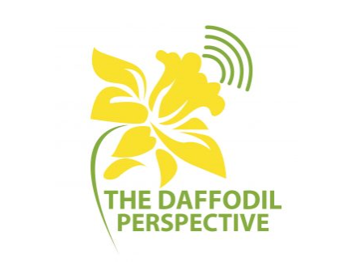

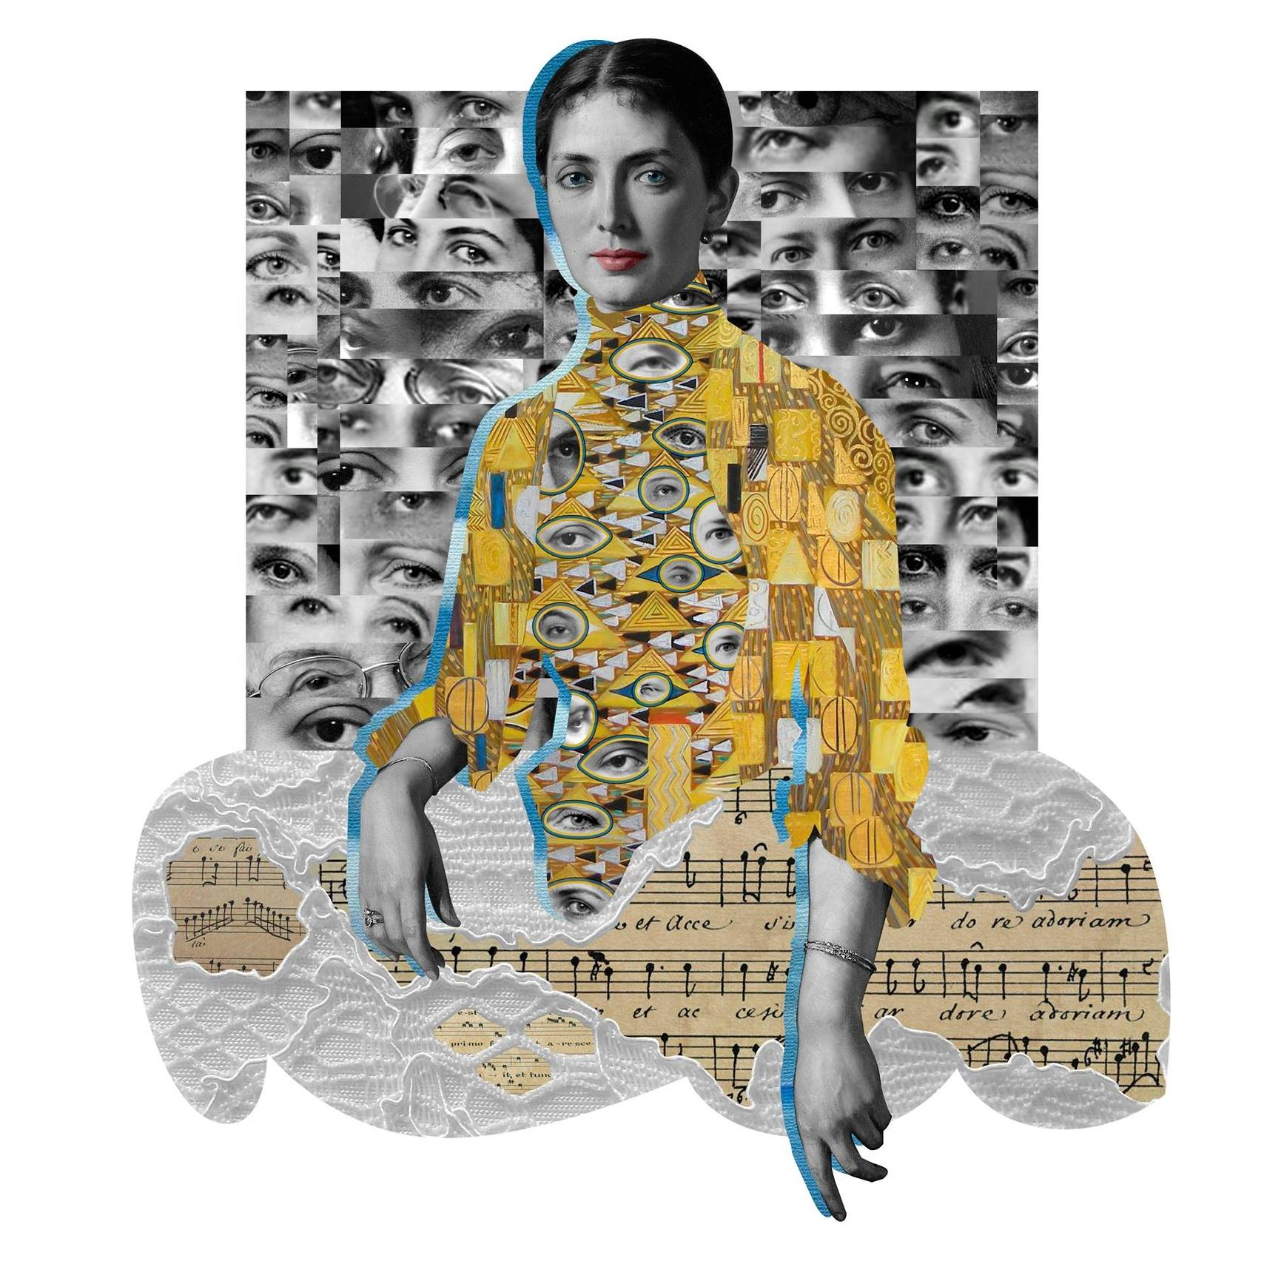
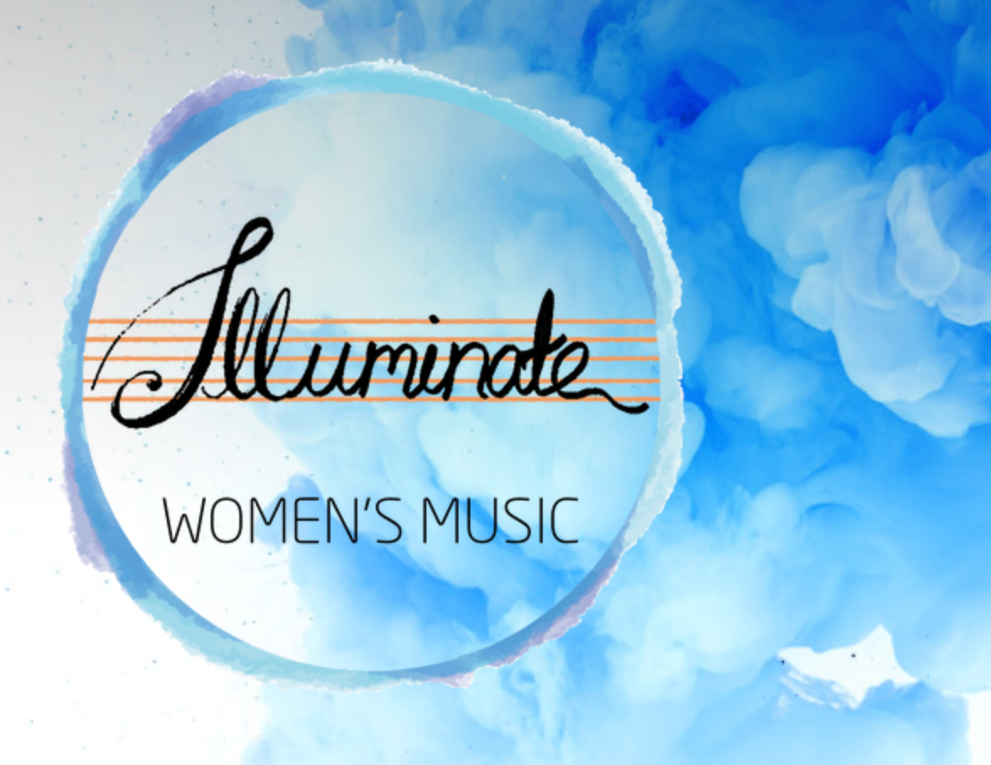
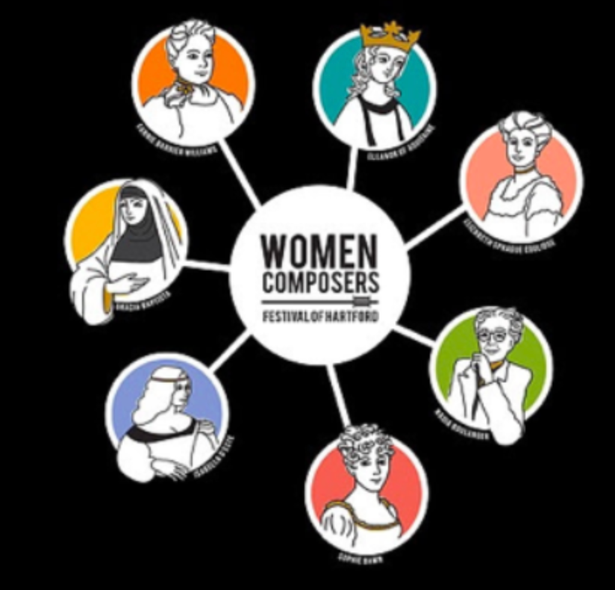
Boulanger Initiative: promoting the work and performance of women composers
The Daffodil Perspective: the classical music radio featuring women composers
Donne: Women in Music: daily posts on women composers
Illuminate Women’s Music: promoting the work and performance of women composers
Women Composers Festival of Hartford: festival for choral and non-choral active composers

Slide 35
Twitter Hashtags
#Hearallcomposers
#Womencomposers
#femalecomposers
#womeninmusic
award winners, lesser known composers, new developments
#Compositoras
#WomeninClassicalMusic
#Womenalsocomposestuff

Slide 36
Publishers/ Publications
7 publishers have filters for or feature gender filters

Slide 37
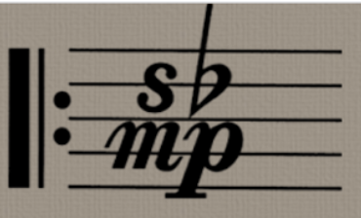






Santa Barbara Music Publishing: filter by choosing “Woman Composer” from “Classifications” search criteria
Hildegard Music Publishing: features all women composers
Candadian Music Centre: search by male, female, or genderqueer using “Advanced Search” within “Composers”
The Contemporary Music Centre of Ireland: search by men/women by selecting “Composers”
Furore Verlag: catalog section on women composers
Sounz Centre for New Zealand Music: enter “women” in the search bar to filter for women
Australian Music Centre: select “Find Music,” then “Browse Composers” for male, female, or nonbinary composers

Slide 38
Databases and Search Engines
Finding scores, filtering results

Slide 39
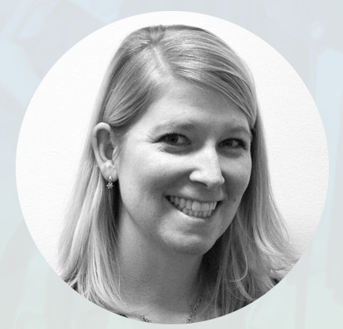


Dr. Jami Lercher’s Major Works List: Includes voicing, instrumentation, timing, nationality and dates of composer. Includes publisher link.
Orange County Women’s Chorus Women Composer’s Database: Compiled by Magen Solomon and Eliza Rubenstein. Searchable by difficulty, timing, voicing, nationality/dates of composer, with composer website links
Musica.org: Highly searchable by multiple variables including gender. Choose “Composer” and add “F” for female/women composers. Records vary in the amount of information available.

Slide 40
Institute for Composer Diversity’s Choral Database

Slide 41

Search ICD: www.composerdiversity.com/choral-database
Get Involved: https://www.composerdiversity.com/get-involved
Composer Sign Up: https://www.composerdiversity.com/composer-database-submission-form
Contact us: choral@composerdiversity.com
This presentation and live links can be found at: Choralmusicbywomen.wordpress.com

Slide 42
